Slide 1
HR Analytics Project
October 2026
Presented by:
Mariam Abdullateef
Understanding Why Employees Leave & How to Retain Top Talent
Data:1,470 Employees| 237 Attrition| Source: IBM HR Dataset 2026

Slide 2
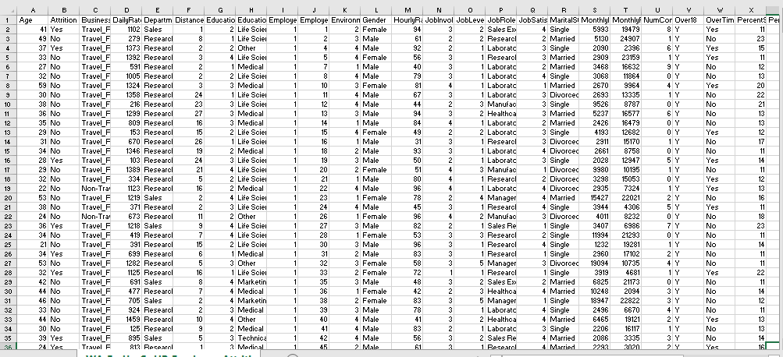
About the Data Set
This dataset is about HR Employees Attrition Information.
The dataset shows information from IBM HR Analytics. It includes details like Age, Department, Monthly Income, Job Satisfaction, Overtime, Attrition (Yes/NO), Total Employees (1,470), KPIs and other factors affecting employee leaving.

Slide 3
To analyze data, find patterns, and understand why employees are leaving
To think of ideas and test them
To get insight that companies can use to improve their staff performances and retain their employees.
Why explore this Data Set

Slide 4
FORMULAS AND CALCULATED FIELDS USED
1. Basic KPIs:
Attrition Count = COUNT where Attrition = 'Yes' (Result: 237 Employees left)
Total Employees = COUNT(EmployeeNumber) (Result: 1,470employees)
Attrition Rate = Attrition Count / Total Employees * 100 = 237/1470 = 16.12%.
Count formula to get Attrition and Total Employees. Attrition Rate formula and average Income formula to get other KPIs
2. Average Income
Avg Monthly Income = AVERAGE(MonthlyIncome) Formula: SUM(MonthlyIncome) / Total Employees = $6,503
3. Monthly Income Grouping
Monthly Income Bin (New Field): IF MonthlyIncome <3000 THEN "0K-3K" ELSEIF MonthlyIncome <6000 THEN "3K-6K"
ELSEIF MonthlyIncome < 9000 THEN “6k-9k…..
Age Group (New Field): IF Age <25 THEN "18-25“ ELSEIF <35 THEN "26-35" ELSEIF Age < 45 THEN “36-45” ELSEIF Age < THEN “46-55” ELSE “55+” -young age 25-35 has the highest attrition
4. Department and Overtime Analysis
Attrition by Department = COUNT Attrition=Yes GROUP BY Department
Overtime Impact = COUNT Attrition=Yes GROUP BY OverTime (Yes/No) This proved 50% who do overtime leave.
New Age Group Bins was created for monthly income and Age to find which group leaves the most and which group the
lowest monthly income and highest monthly income.

Slide 5
Key Metrics At a Glance
Attrition Count
237
Total Employees
1,470
Avg Monthly Income
$6,503
Attrition Rate
16.12%
16% of workforce left- slightly above industry average (15%)
Each attrition costs ~1.5x salary to replace
Focus: Sales & R&D, Young 25-34

Slide 6
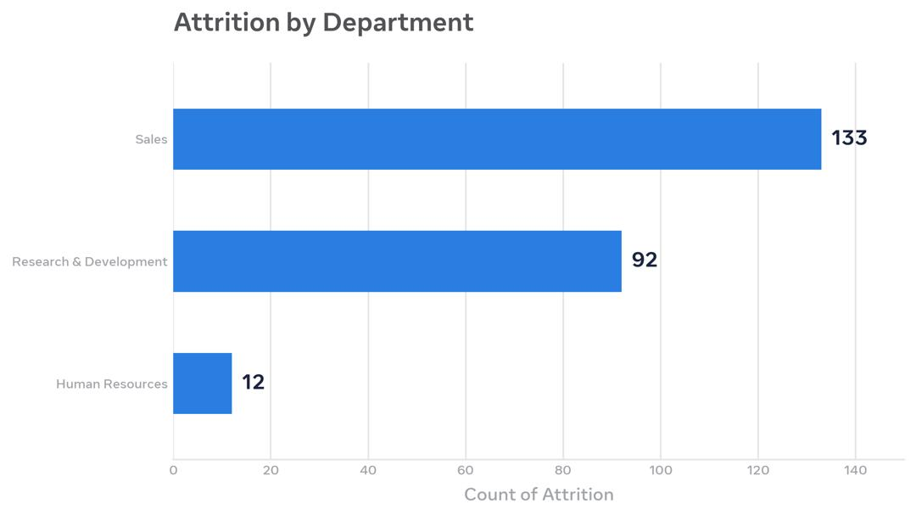
Attrition by Department &
Sales: Highest Attrition – 133 left
R&D; Second Highest -92 left
HR: Lowest Attrition – 12 left
Sales team under highest pressure
FIX: Focus retention on Sales Department, improve commission and work-life balance

Slide 7
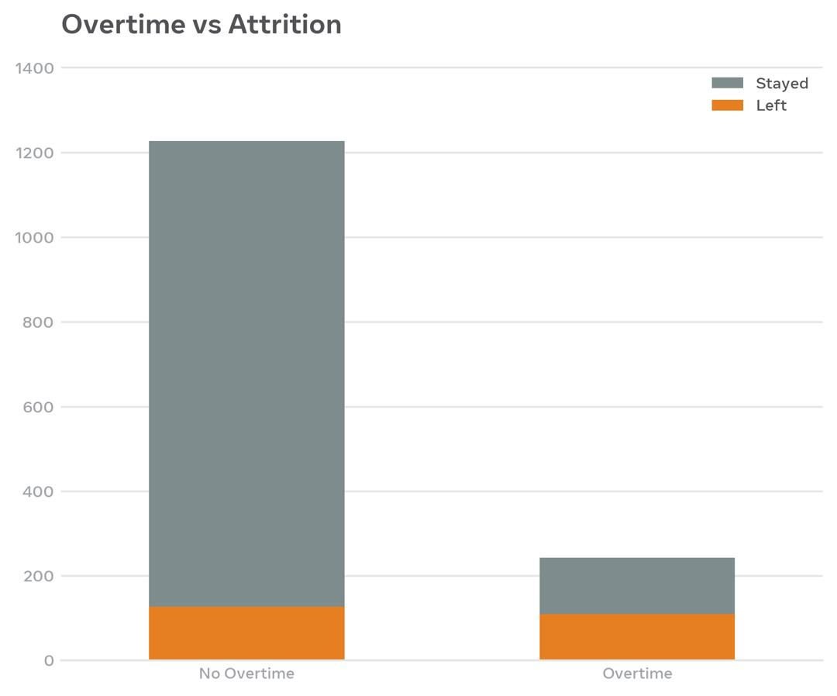
OVERTIME AND DOES AGE AFFECT INCOME AND ATTRTION?
Overtime –Biggest Driver
Overtime Yes: 50% leave (127 of 253)
Overtime No: 9% leave (110 of 1,217)
No Overtime = 5x more likely to say
FIX: Reduce forced overtime, hire more staff and pay overtime allowance
YES. Monthly Income Increases with Age.
Lowest Income: 18-25 years. They are entry level
Highest Income: 51-60 years. They are Senior level.
However, Attrition analysis is to show employees between the age group of 24-35 years leaves the most. Even though, they are not the lowest paid. Other factors for Attrition are; overtime, low job satisfaction, and career growth. From the HR analytics, salary is not the only factor for Attrition.

Slide 8
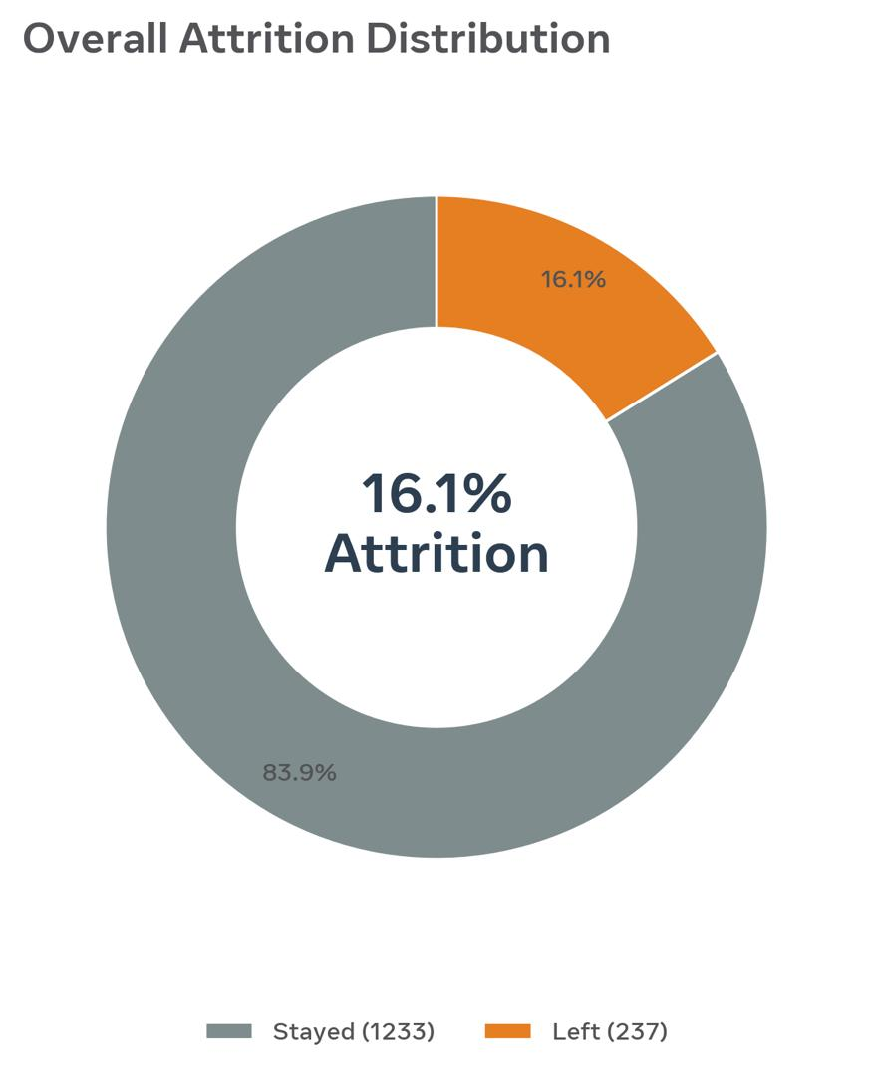
Overall Attrition Rate
Overall Attrition:
Total Employees: 1,470
Left: 237 employees (16.12%)
Stayed: 1233 employees (83.88%)
Insight: 1 in 6 employees leaves – need urgent retention strategy
Recommendation: Improve work-life balance, review salary and reduce overtime.

Slide 9
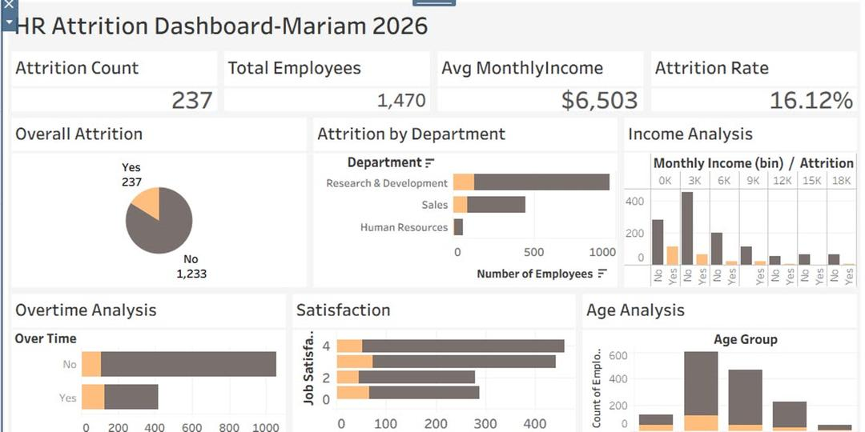
DASHBOARD OF HR ATTRITION DATASET

Slide 10
ANAYLYSIS REVIEW AND EXPLANATION OF WHOLE DASHBOARD
Overall attrition is 16.12% - 237 of 1470 employees left.
Sales Department has highest attrition (133) – under high pressure.
Overtime is biggest driver – 50% who do overtime leave vs 9% who don’t.
Young employees (25-35) and low income group leave more.
Single employees with frequent travel leave more than married staff.
Business needs to reduce overtime and improve work-life balance
WHAT DOES OUR
DASHBOARD SHOW?

Slide 11
LESSONS LEARNT
Learned to clean HR data, missing value and duplicate using power query
Used Tableau to create attrition Charts; Department, Overtime, Age group, Overall Rate, Satisfaction and Income analysis.
Learned to find patterns , Sales and Overtime link to Attrition
Learned how to use formula to generate 4 KPIs
Learned how to convert raw HR data into insights for management decision.
In all, learned how to use data to solve real company problems on how to retain employees

Slide 12
THANK YOU
FOR YOUR
ATTENTION
THANK YOU FOR YOUR ATTENTION
mabdullateef22@yahoo.com
08035314379
Mariam Abdullateef

